Slide 1

Local Waste Service Standards Project – Proof of Concept
Administered by the DCLG Local Digital Programme
Supported and funded by DCLG Waste Policy Team
Building on the work of the LocalGov Digital Local0 Project

Slide 2
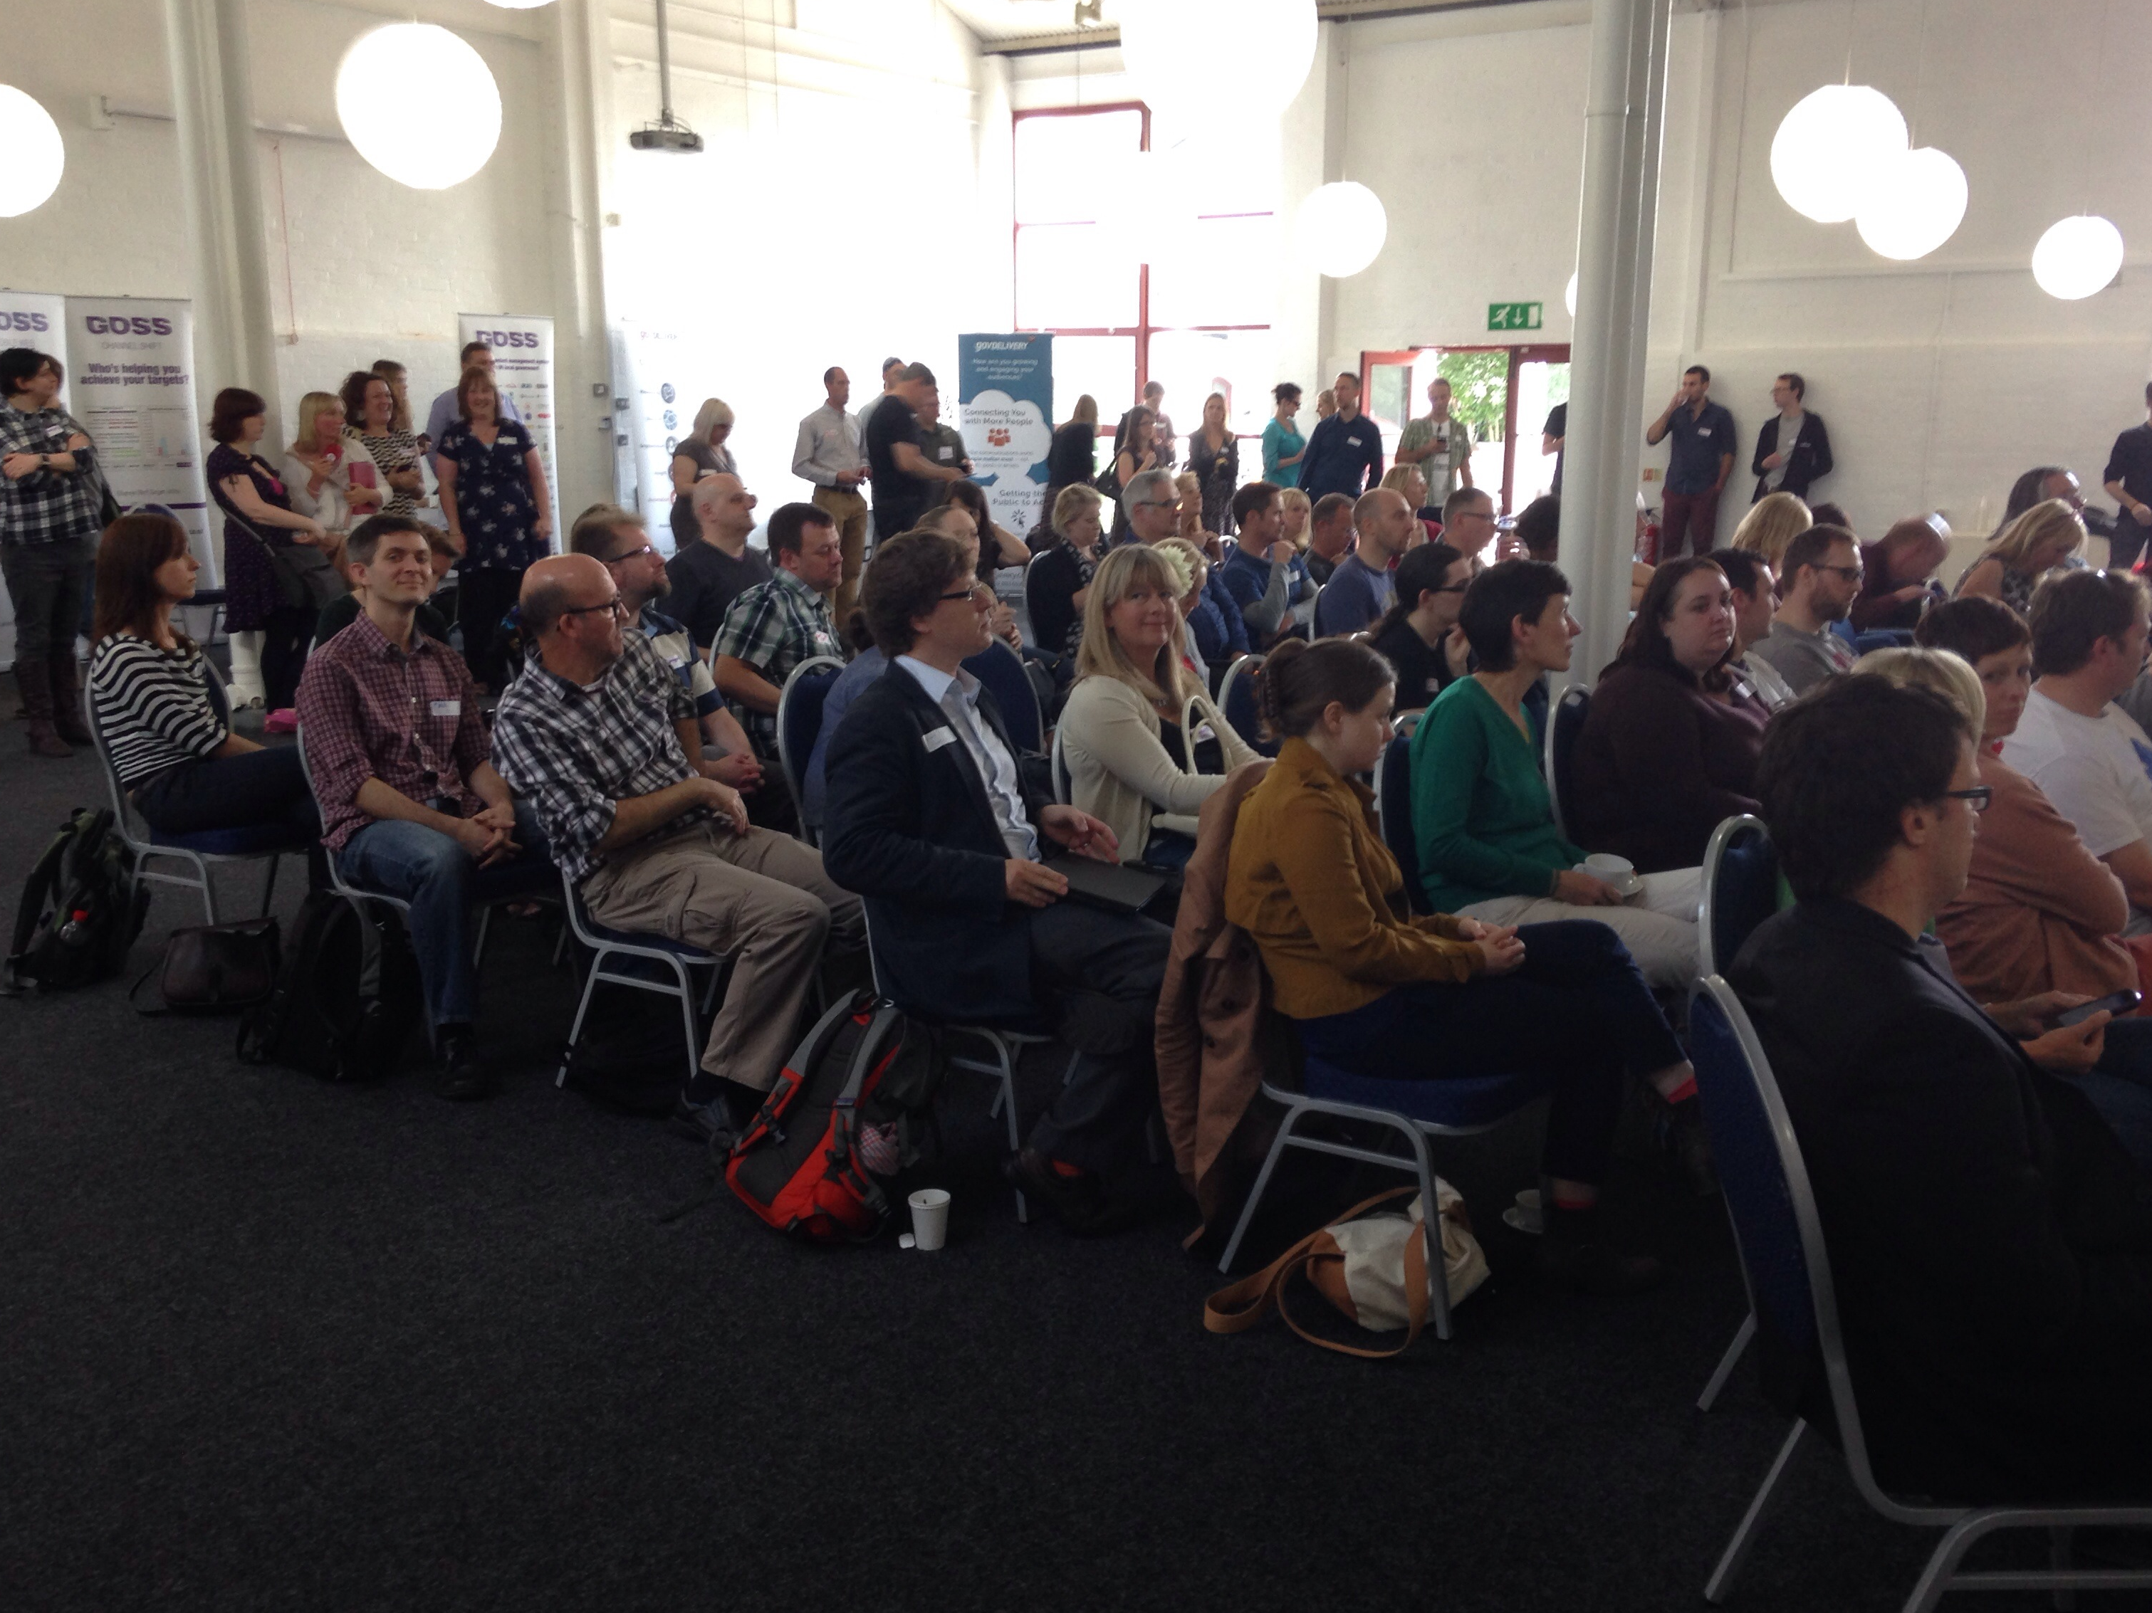
Background on the Waste Service Standards Project
Project started at Local Gov Camp, June 2014
Services would be better and cheaper if they shared data standards
Councils lacked the resource to transform services in a standardised way

Slide 3
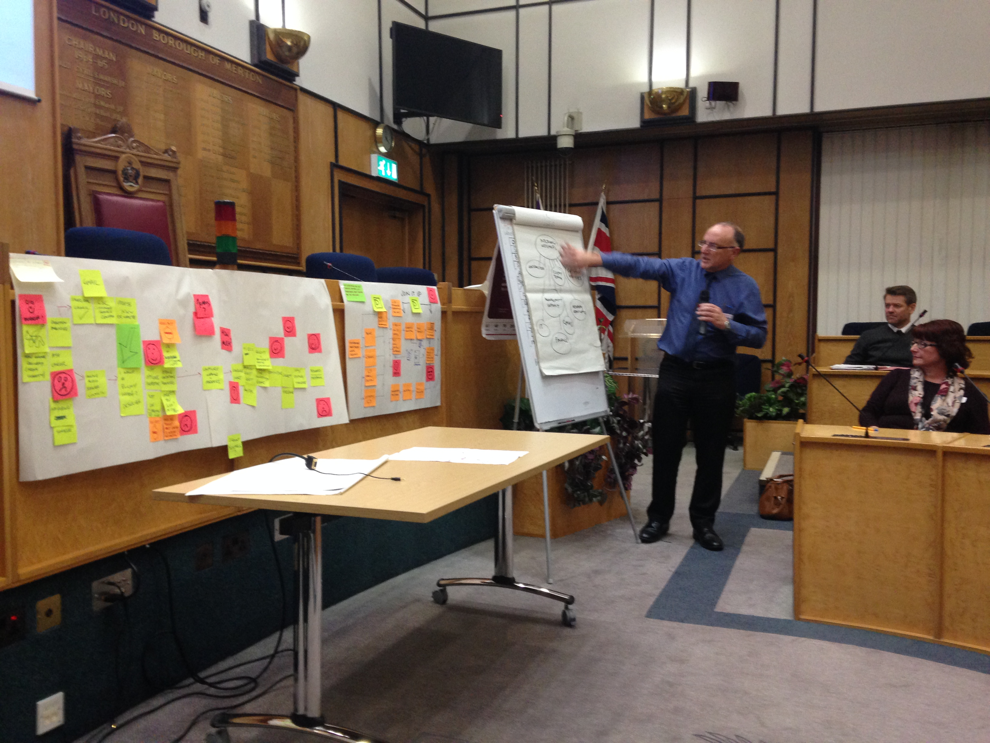
DCLG Local Digital Programme hosted Waste service Standards Discovery Day in Merton, Nov 4th 2014
Agreed standards needs to be implemented and tested
Suppliers need to be engaged
Need to find a way to reach critical mass of standard users (without boiling the ocean)

Slide 4
Waste service standards project aims
Collaborative standards design
Sector-led
Establish a data standard and supporting tools for local waste services to
enable better digital services = reducing call volumes and failure demand
enable LA collaboration
Enhance purcahsing power and push suppliers to build APIs according to common standards
increase transparency around the performance of services, and of suppliers
enable LAs to move between suppliers more easily
enable ‘government as platform'
Notes:
Design a collaborative method for establishing and implementing local digital service standards – starting with waste
Enable the local government sector to lead on establishing standards for its waste services (rather than have standards imposed from the outside)
Establish a data standard and supporting tools for local waste services and help to improve the services for participating local authorities

Slide 5
Waste service standards project method
Agile: first iterations of process and products delivered in 9 months
MVC to establish the priorities and content of standards
Consult the wider sector – public and private
Work out loud
Notes:
Work in an agile way, aiming to deliver a first iteration of the process and the products within 9 months
Work with a representative group of local authorities to establish what the priorities should be to start with, and to get agreement from all involved on the content of the standards
Consult the wider sector in the discovery phase of the project, but ensure that decisions and progress can be made by working primarily with a ‘Minimal Viable Collaboration’ of Local authorities and their suppliers.
Work out loud

Slide 6
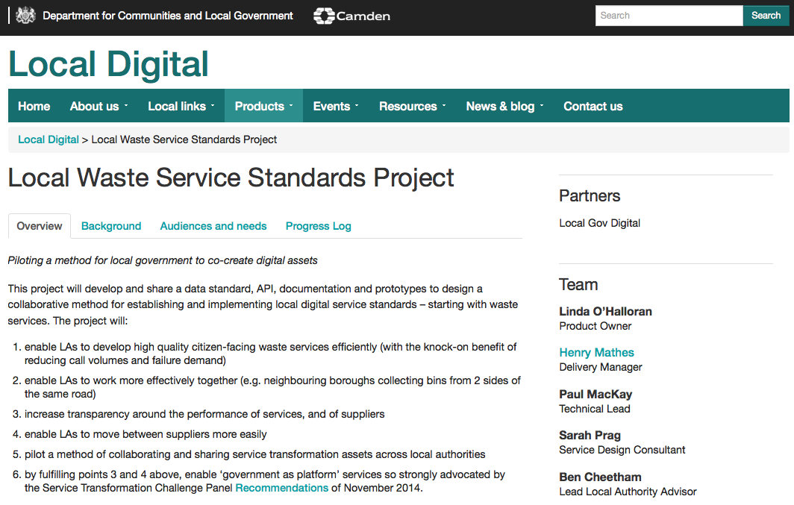
Working Out Loud Project Page
Notes:
http://www.localdirect.gov.uk/product/local-waste-service-standards-project/

Slide 7
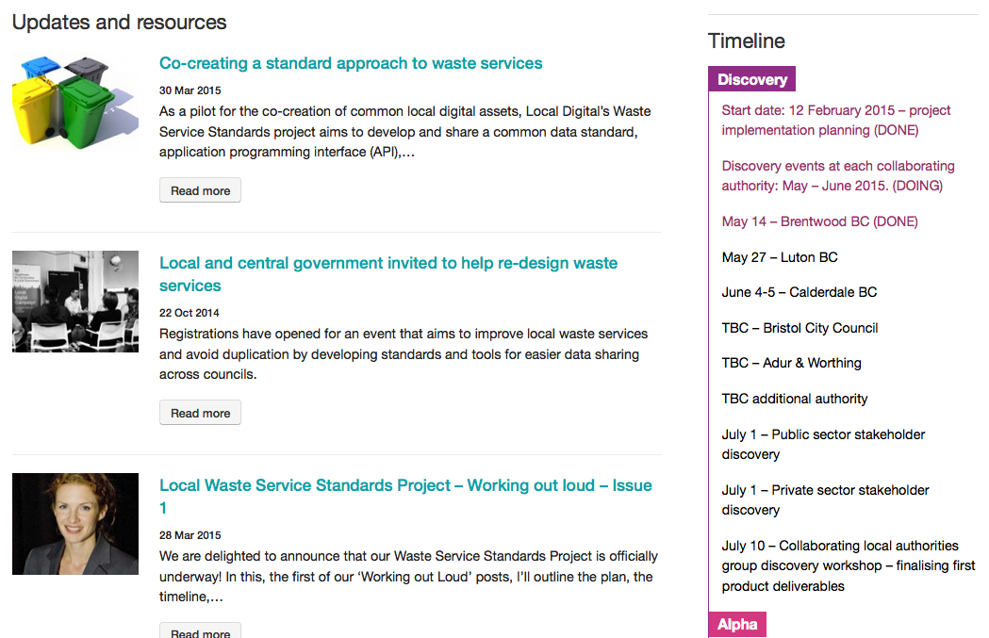
Notes:
http://www.localdirect.gov.uk/product/local-waste-service-standards-project/
We’ll post our progress through the timeline and blogs, and we’ll publish all associated documentation to the page too.

Slide 8
Waste service standards project roadmap
Discovery phase
Discovery days with each LA
Discovery session with public sector stakeholders
Discovery session with commercial sector
Collation of needs into a backlog and roadmap
Review of backlog and roadmap with LAs
Beta phase
One or more LAs
implement live changes.
The project team offers:
- Implementation audit
- Implementation planning
- Service design support
- Tech support
Show & tell
Alpha phase
Develop, share & publish
alpha versions of:
- data model
- publishing standard
- API specifications
- referencing
implementation
Show & tell
May June July August Sept Oct Nov Dec
You are here

Slide 9
Running order of the day
Introductions
Your business context
Service deep dive
Residual waste collection
Recycling collection(s)
Opportunities to improve/ redesign waste services

